Slide 1



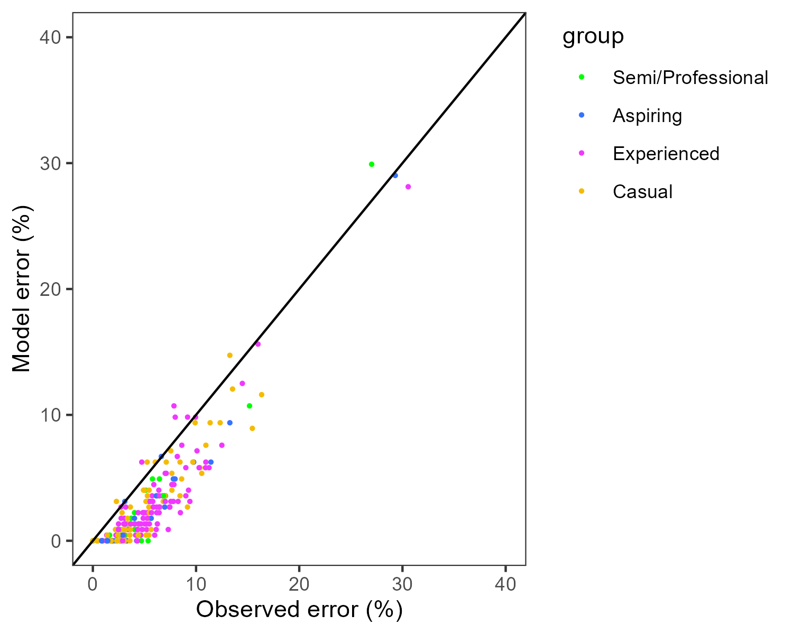
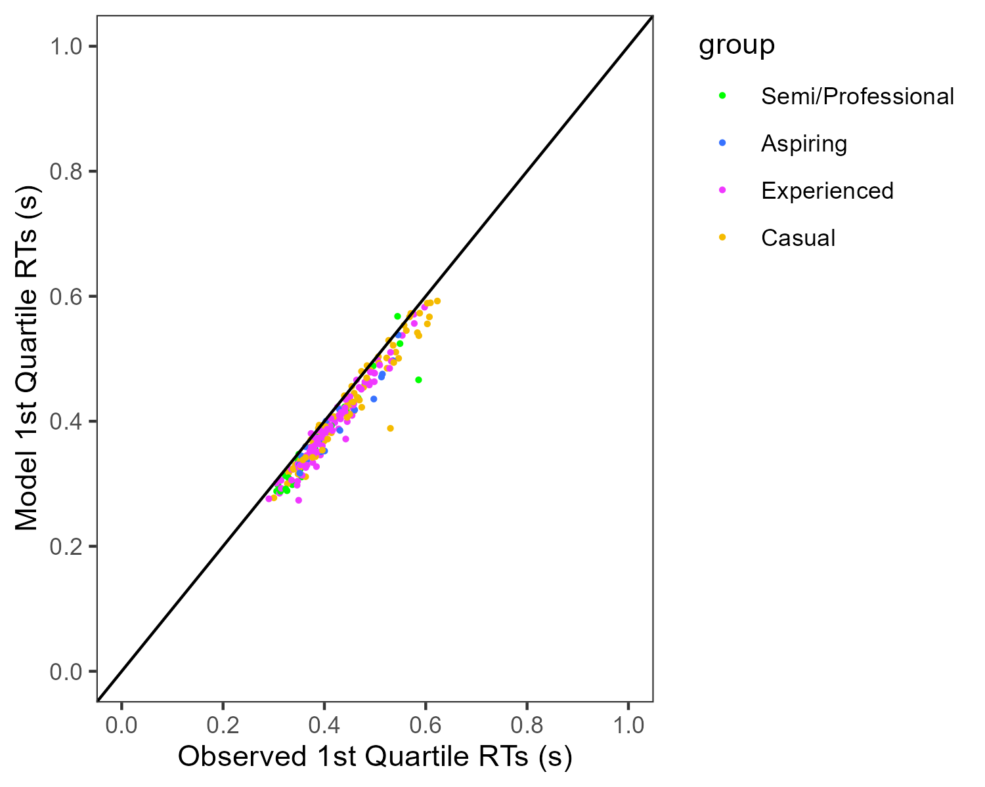
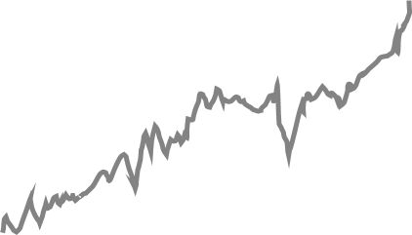
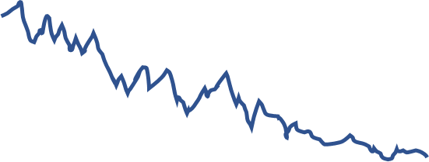
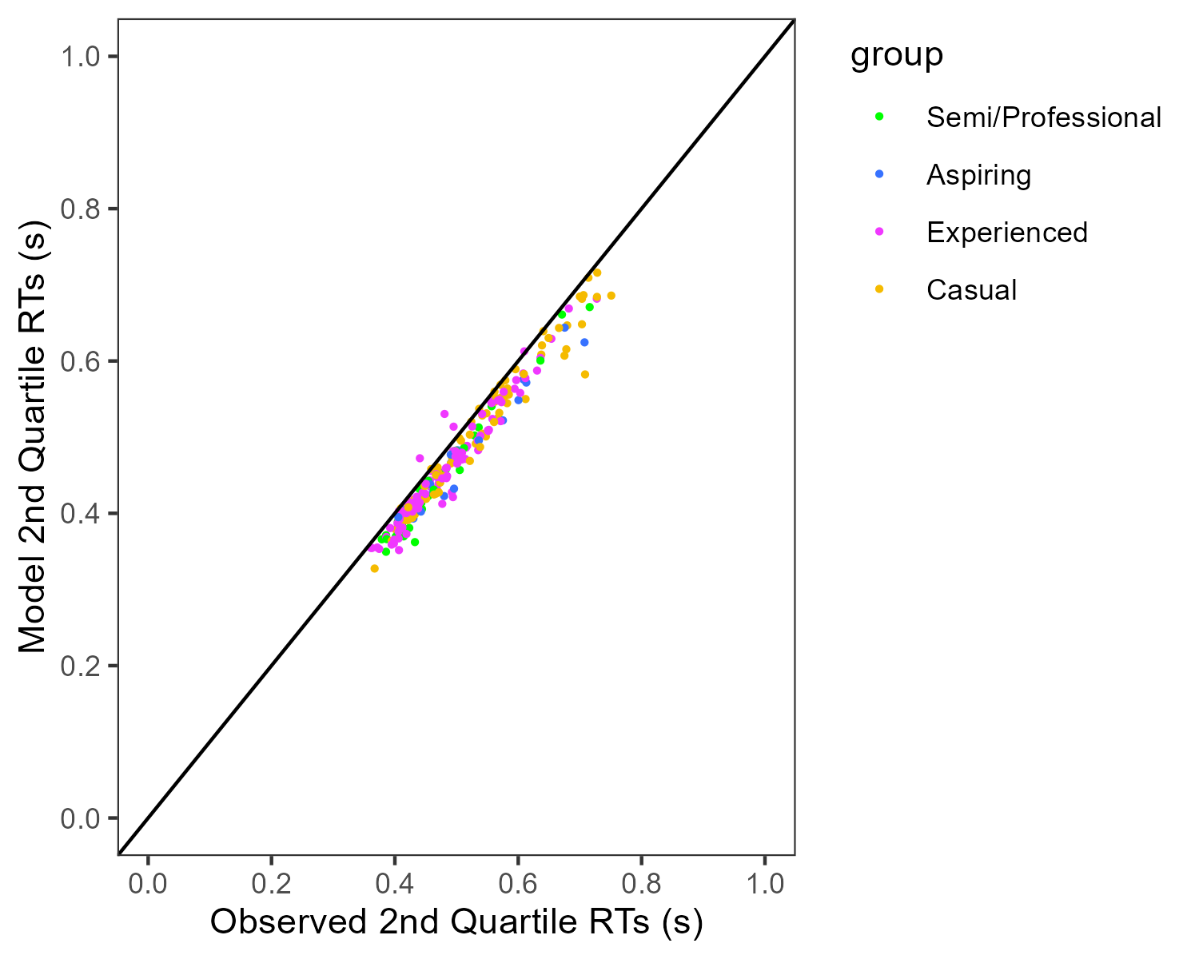
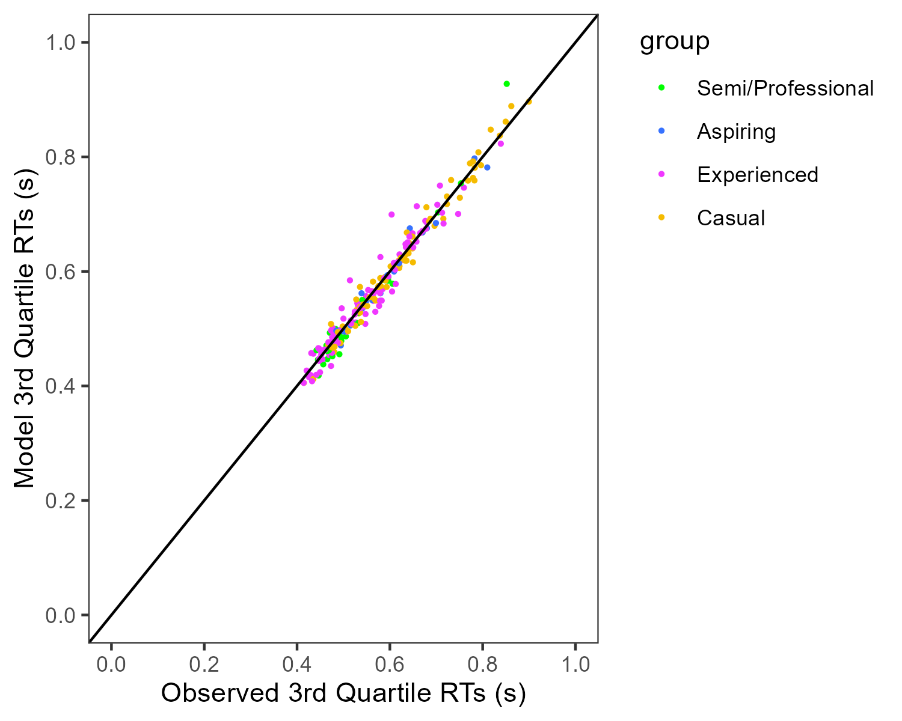

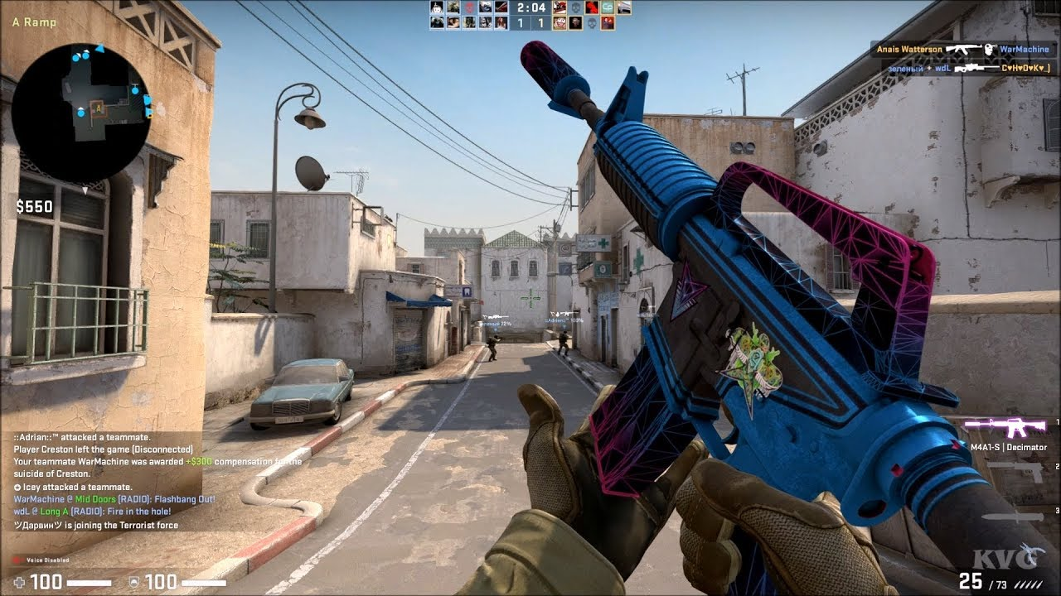
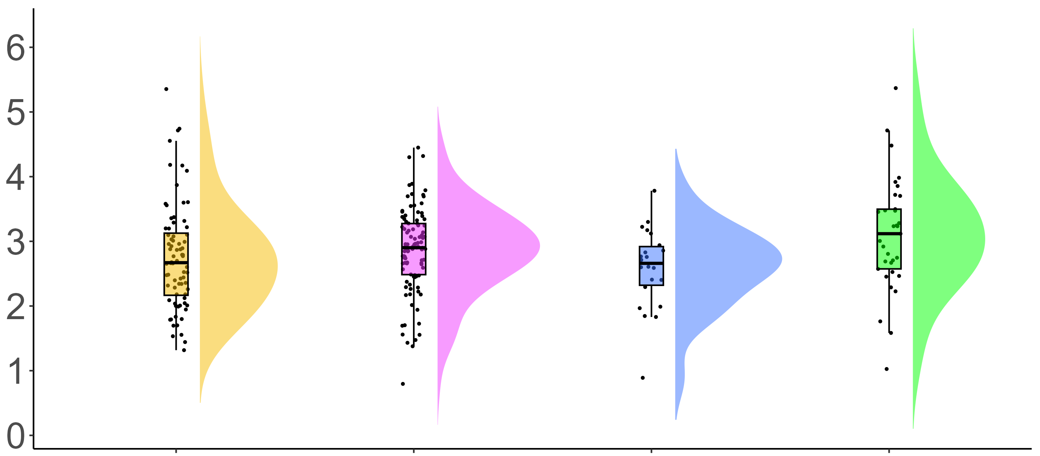
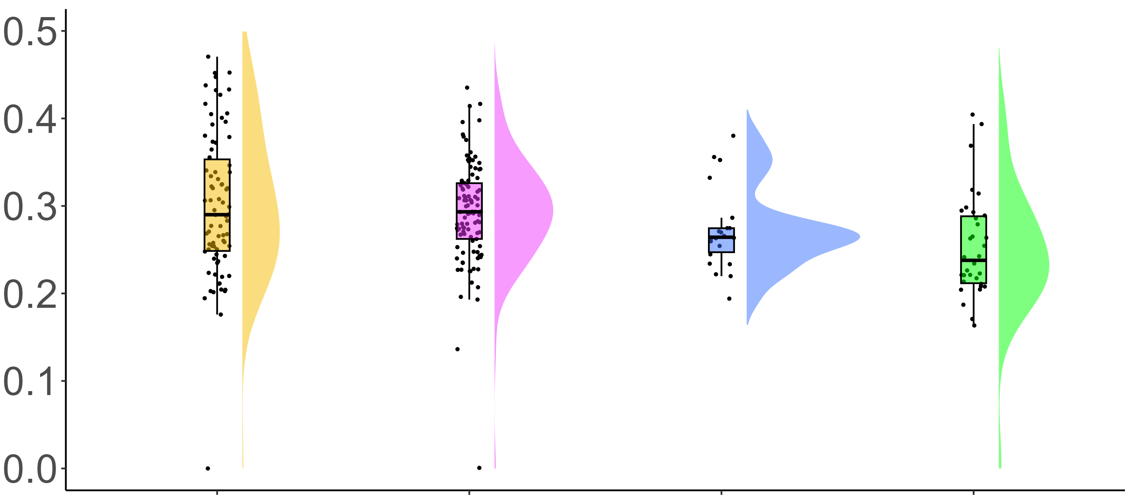
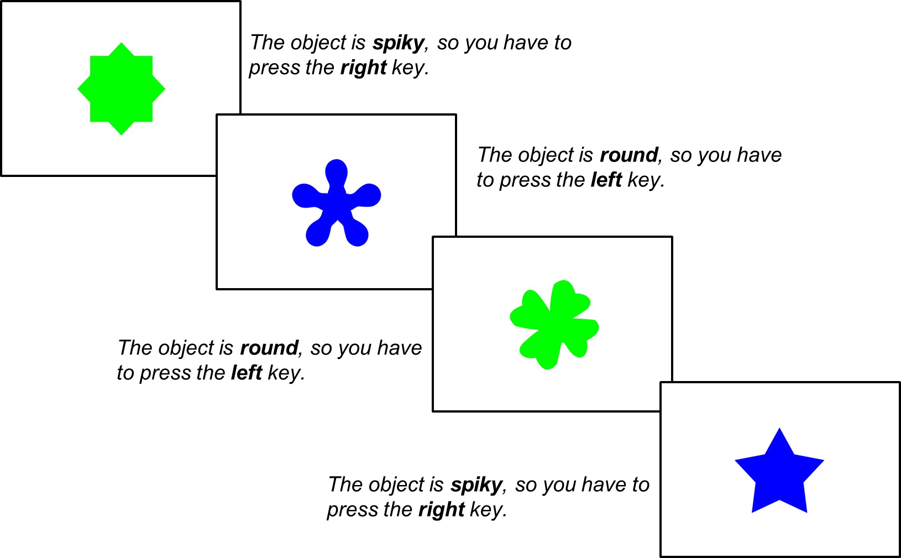

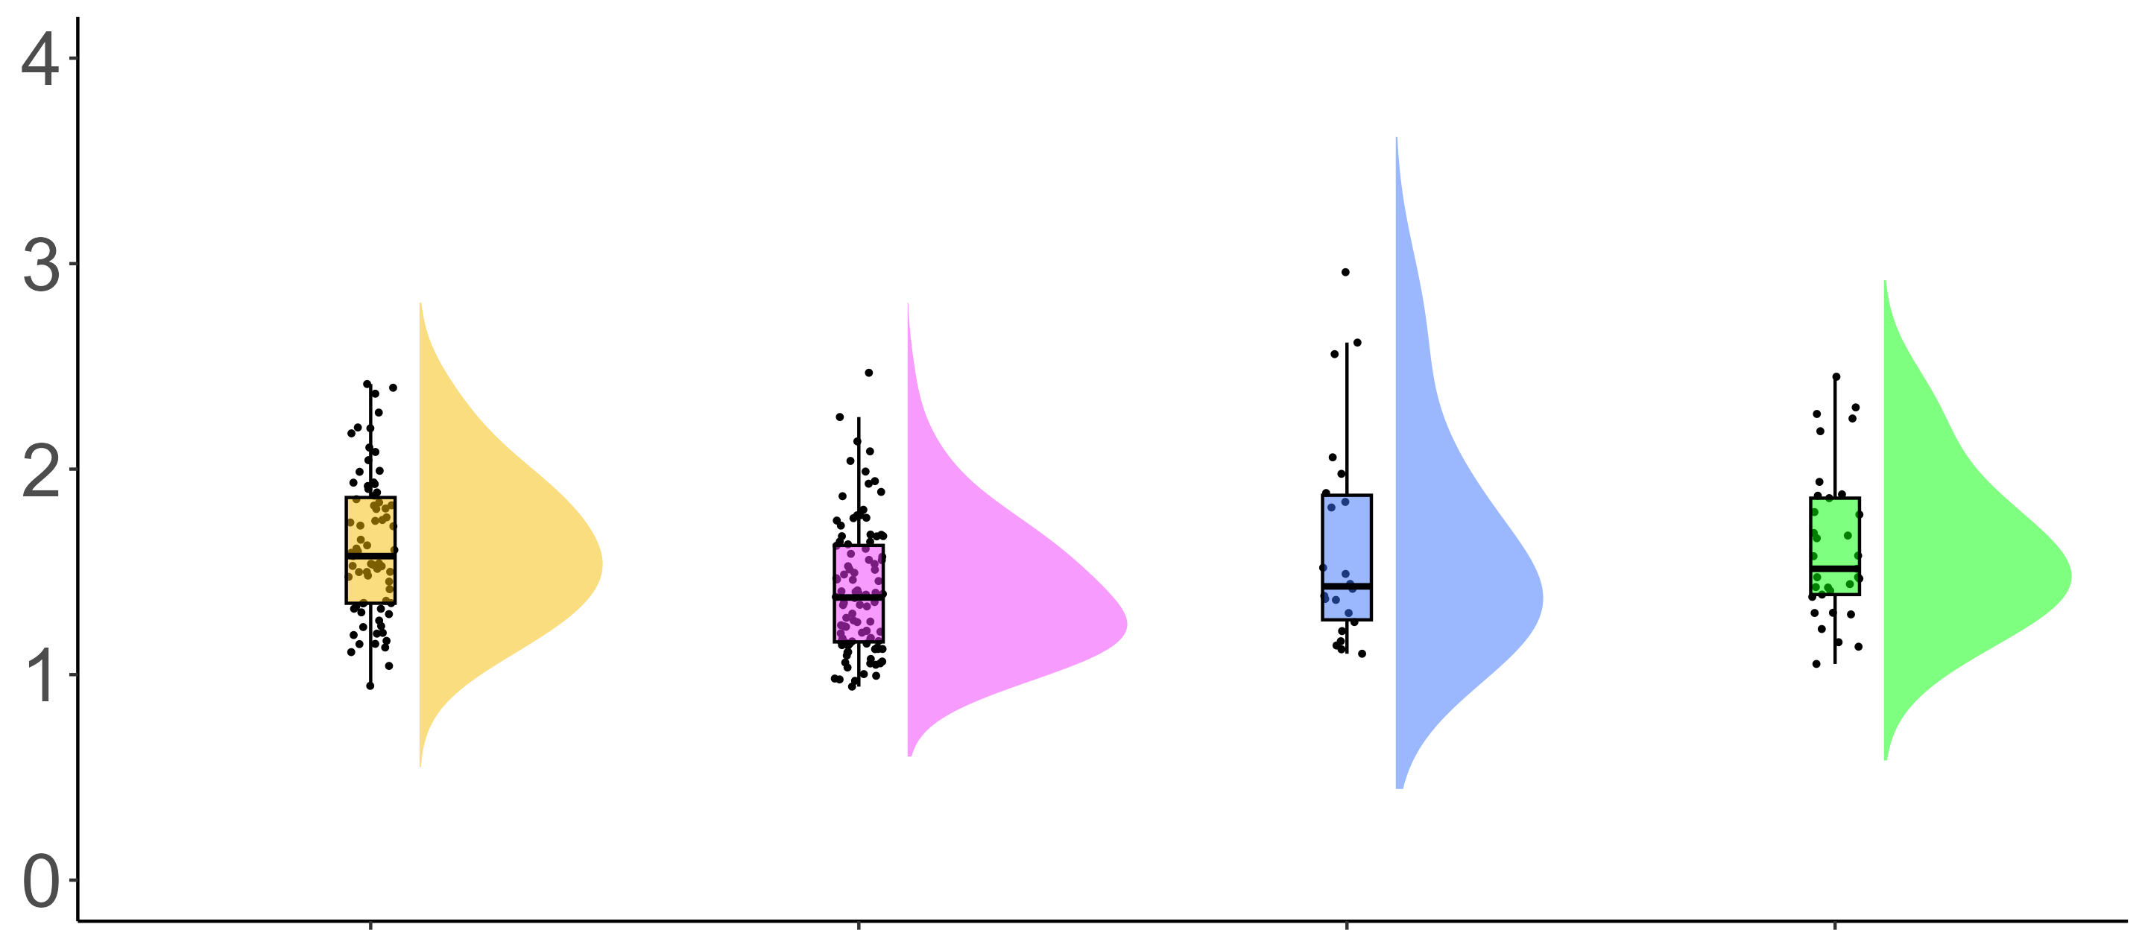
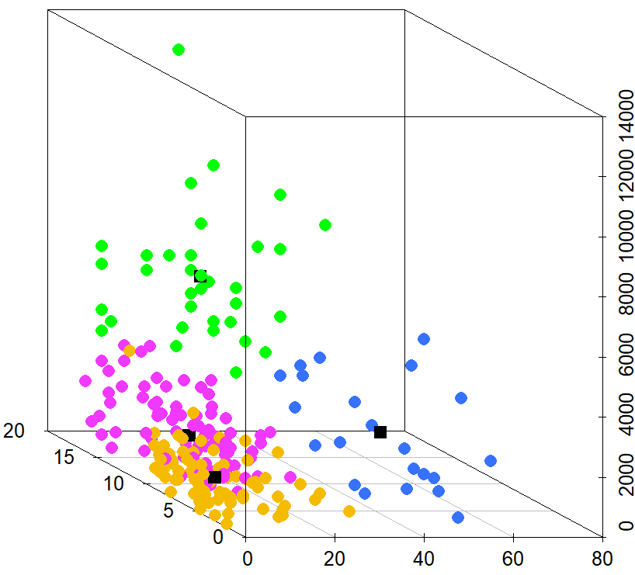
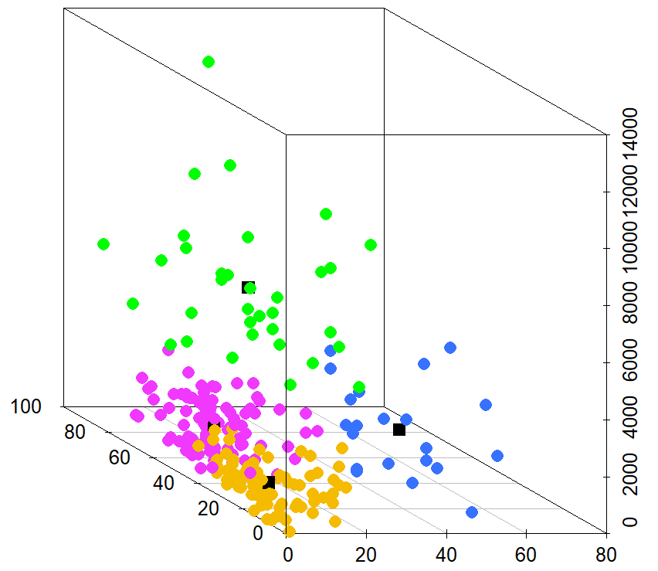
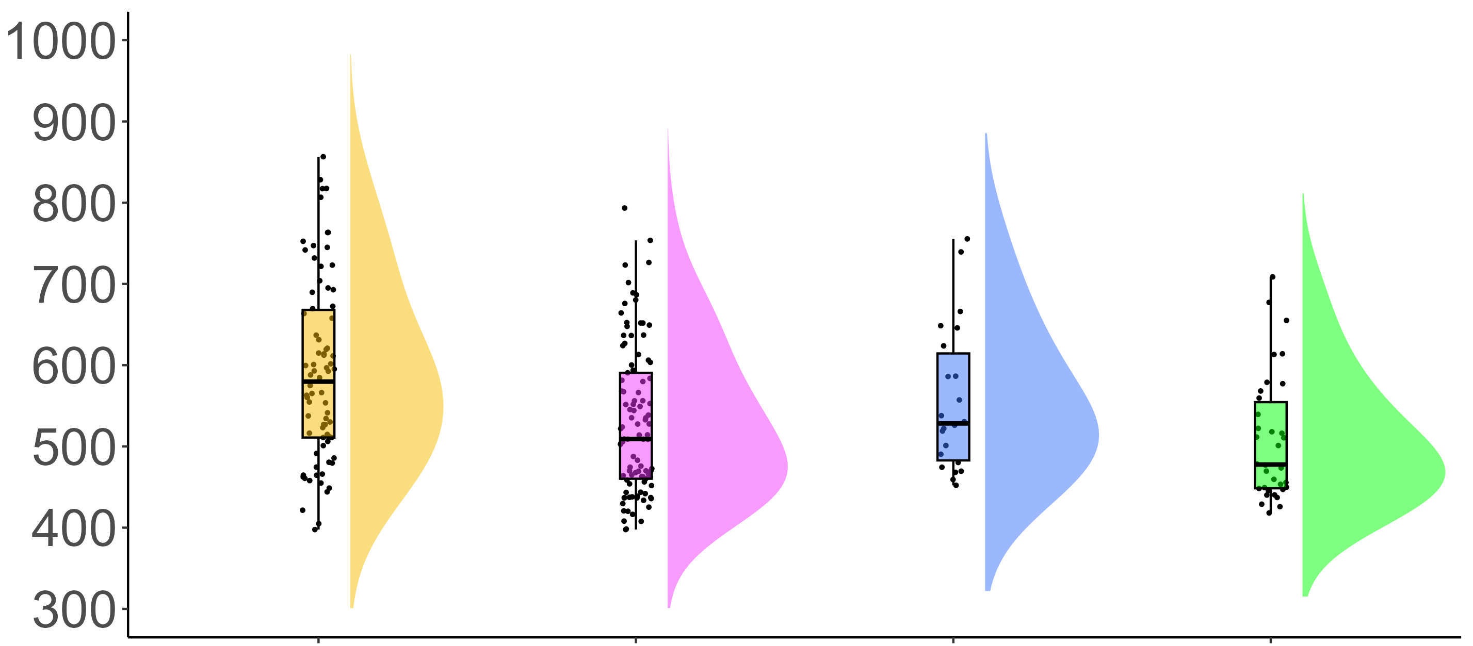

COGNITIVE CORRELATES OF ACTION VIDEO GAMING: A CROSS-SECTIONAL STUDY OF COUNTER-STRIKE PLAYERS
Eleanor R. A. Hyde, Robert Schmidt, Daniel J. Carroll, & Claudia C. von Bastian
erahyde1@sheffield.ac.uk eleanorhyde.com @era_hyde
Drift-Diffusion Modelling
Background
Action video games (AVGs) are fast-paced, dynamic video games which require quick decision-making.
Research shows an inconsistent association between AVG play and processing speed^{1, 2}.
By decomposing reaction times (RTs) using the drift-diffusion model (DDM)³, researchers found AVG training to improve drift rates⁴, whilst others found AVG training to increase boundary separations² .
These mixed findings may be due to methodological limitations such as small samples, broad definitions of AVGs.
It remains unclear how to measure AVG expertise if there is a relationship between AVG expertise and processing speed.
Counter-strike: Global Offensive (CS:GO) is a popular AVG and the focus of this study.
Correct response
Starting point
Boundary Separation
Drift rate
Incorrect response
Stimulus encoding
Decision time
Response execution
F(3,231) = [2.13], p = .098
Research Questions
Drift rate (ν)
How should CS:GO expertise be measured?
Is greater CS:GO expertise associated with faster processing speed?
Do the decision processes underlying processing speed differ with CS:GO expertise?
M = 2.86, SD = 1.07
M = 2.90, SD = 0.77
M = 2.59, SD = 0.62
M = 3.20, SD = 1.05
Method
F(3,231) = [5.37], p > .001
Choice RT Task
CS:GO Expertise Questionnaire
Total hours playtime
Weekly hours playtime
Self-rated expertise
Current ranking
Non-decision time (t0)
M = 0.30, SD = 0.08
M = 0.29, SD = 0.06
M = 0.27, SD = 0.05
M = 0.25, SD = 0.07
K-Means Clustering
F(3,231) = [1.81], p = .150
Boundary separation (α)
Total hours playtime
Total hours playtime
M = 1.78, SD = 0.90
M = 1.50, SD = 0.91
M = 1.64, SD = 0.52
M = 1.85, SD = 1.34
Casual
Experienced
Group
Aspiring
Semi/Professional
Current ranking
Weekly hours playtime
Self-rated expertise
Weekly hours playtime
Results
Casual N = 78 Experienced N = 101 Aspiring N = 22 Semi/Professional N = 34
Clustering is a viable method of identifying expertise groups in CS:GO players.
High expertise CS:GO players demonstrate faster processing speed in terms of faster RTs in a Choice RT task, with no differences in accuracy.
DDM suggests that RT differences were mainly due to faster non-decision times (t0).
Processing Speed
F(3,231) = [7.52], p > .001
RT (ms)
Take Home Message
AVG expertise is a multi-dimensional construct that should be captured by a range of measures.
Highly expert AVG players show advantages in processing speed, encoding and response execution – showing transfer from a video game to a cognitive task.
M = 591, SD = 112
M = 530, SD = 91
M = 556, SD = 89
M = 508, SD = 77
Casual
Experienced
Group
Aspiring
Semi/Professional
Scan for references and additional figures

